Slide 1
Traffic Signs

Slide 2
CONTENTS
Traffic signs Introduction
Type of signs
Traffic signals
Advantages and Disadvantages
Colour used in traffic signals
Fix Time Signals and Vehicle Actuated Signals
Conclusion

Slide 3
TRAFFIC SIGNS
Traffic signs or Road signs are signs erected at the side of or above roads to give instructions or provide information to road users.
The general principle of traffic signs is to make a message to known quickly, accurately, with minimum reading skills required.
They give information as highway routes , direction and points of interest.
They give timely warning of hazardous situation when they are not self evident.
They are recognizable by shape and color, message and diagram.

Slide 4
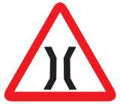
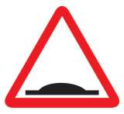

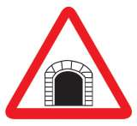
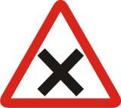
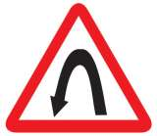
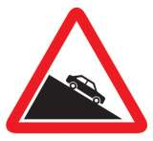
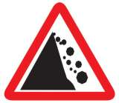
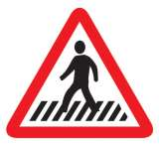
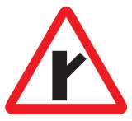
TYPES OF SIGN
Warning or DANGER SIGNS
Danger signs are used when it is deemed necessary to warn traffic of existing or potentially hazardous conditions on or adjacent to a highway or street
These signs have a red borders and the symbols indicated therein are in black colour against a white background
Narrow Bridge Ahead
Speed Beaker Ahead
Tunnel Ahead
T Intersection
Cross Roads
Pedestrian Crossing
Y-intersection-RHS
Left Hairpin Bend
Steep Descent
Falling Rocks

Slide 5


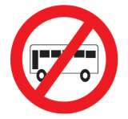
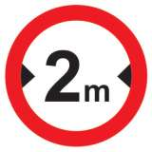
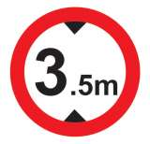


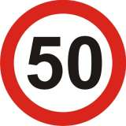
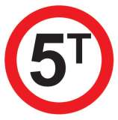

B. REGULATORY SIGNS
Regulatory signs are road sign which are used to set the obligations of all traffic which use a specific area of road.
Most mandatory road signs are circular, may use white symbols on a blue background with white border or black symbols on a white background with a red border.
Right turn Prohibited
No Parking
Buses Prohibited
Maximum width limit
Height Limit
Maximum speed
Overtaking prohibited
Load Limit
No stopping
Horn Prohibited

Slide 6


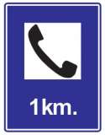
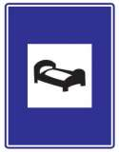
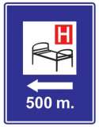

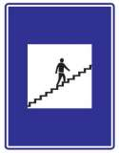
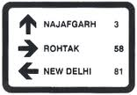

C. INFORMATION SIGNS
Information sign are intended to guide the motorist along street and highways ,to inform him of intersecting routes, to direct him to cities, town, villages or other important destination so it will help him along his way in most simple, direct manner possible
They generally provide information of facilities such as hospital, filling station, eating places, rest house, first-aid post etc.
Refreshment
Repair Facility
Public Telephone
Resting Place
Hospital
Country Border
Foot Over Bridge
Direction sign
Destination sign

Slide 7
TRAFFIC SIGNALS
Traffic Signals use for control of conflicting streams of vehicular and pedestrian traffic is extensive in most of the town and cities.
Traffic signals are designed to ensure an orderly flow of traffic, provide an opportunity for pedestrians or vehicles to cross an intersection and help reduce the number of conflicts between vehicles entering intersections from different directions.
Fixed-time signals follow a predetermined sequence of signal operation, always providing the same amount of time to each traffic movement, whether traffic is present or not.
Actuated signals change the lights according to the amount of traffic in each direction

Slide 8
ADVANTAGES
Provide for orderly movement of traffic
Increase traffic-handling capacity of an intersection
Reduce frequency and severity of certain types of crashes
DISADVANTAGES
Excessive delay
Increased traffic congestion, pollution
Increased use of less-adequate streets

Slide 9

COLOURS USED IN TRAFFIC LIGHTS
Red – Stop and remain stopped as long as the signal is red
Amber- A steady amber light or arrow indicates that the light is about to change
Green – Go IF the way is clear

Slide 10
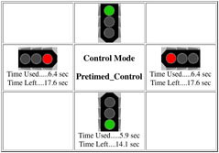
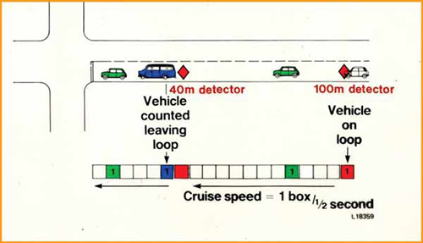
FIX TIME SIGNALS AND VEHICLE ACTUATED SIGNALS
Fix time signal are those in which the green periods very and hence the cycle length are predetermine and of fix duration.
Vehicle actual on the other hand, are those in which the green periods very and are related to actual demand made by traffic.

Slide 11
CONCLUSION
From the detailed study of various traffic signs and signals, we can conclude that the signals being visually helpful, if the signals are used to the maximum potential and place dare required location and of standard quality and sizes, traffic signs will definitely increase road user comfort and reduce accidents.

Slide 12
THANK YOU

